Slide 1
Atomic Structure
Chapter 4

Slide 2
4.1 – Defining the Atom
Objectives
Describe Democritus’s ideas about atoms
Explain Dalton’s atomic theory
Identify what instrument is used to observe individual atoms

Slide 3
Defining the Atom
The Greek philosopher Democritus (460 – 370 BCE) was among the first to suggest idea of atoms (from the Greek, “atomos”)
Believed atoms were indivisible and indestructible
His ideas agreed with later scientific theory, but was based on philosophy
An analogy for Democritus’ atomic theory is a billiard ball

Slide 4
Dalton’s Atomic Theory
Aristotle’s view of elements was the accepted view for nearly 2000 years
Dalton’s theory was one of the first attempts to describe/suggest atoms based on scientific evidence

Slide 5
Dalton’s Atomic Theory
1) All matter is made of atoms, which are indivisible
2) All atoms of a given element are identical in mass and properties
3) Compounds are combinations of two or more different types of atoms
4) A chemical reaction is a rearrangement of atoms

Slide 6
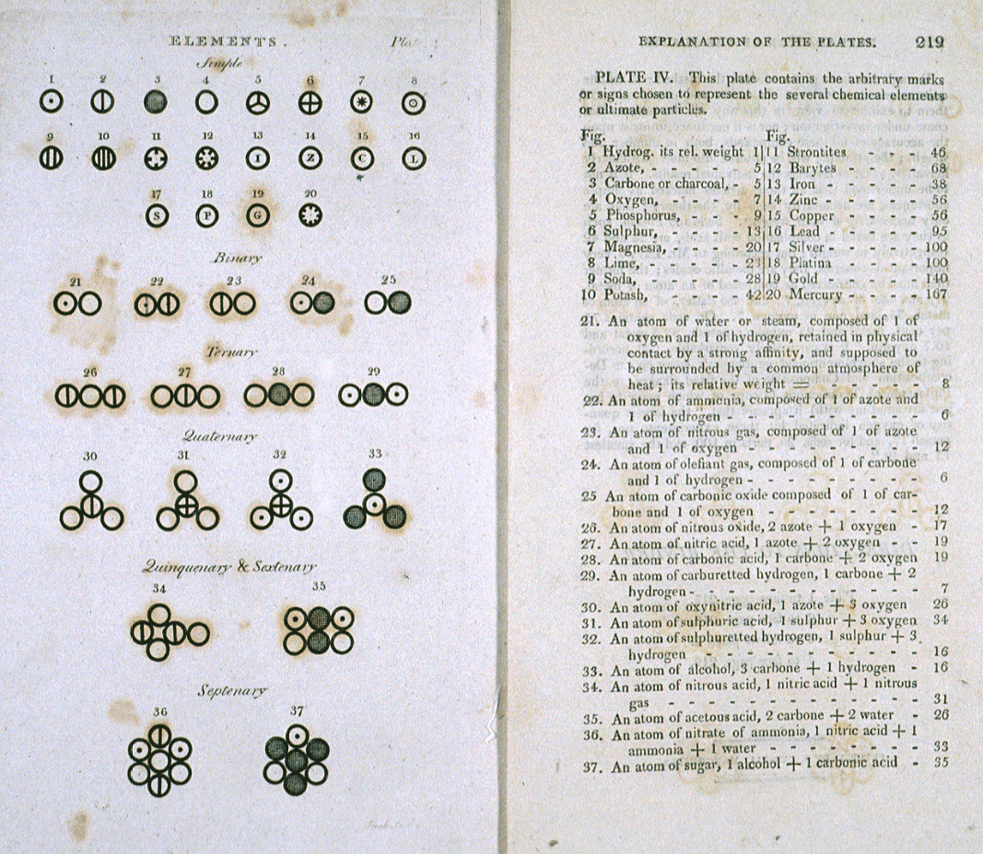
Various atoms and molecules as depicted in John Dalton's A New System of Chemical Philosphy (1808)

Slide 7
Size of atoms
Atoms are the smallest particle an element can be divided into that still has properties of that element
If you could line up 100 000 000 copper atoms in a single file they would be approximately 1 cm long
Despite their size individual atoms can be observed with instruments such as scanning tunneling (electron) microscopes

Slide 8
Left: photograph of a gold nugget
Right: scanning-tunneling microscope image of gold crystal – each sphere is one gold atom

Slide 9
How small is an atom?
https://www.youtube.com/watch?v=yQP4UJhNn0I

Slide 10
4.2 - Structure of the Atom
Objectives:
Identify three types of subatomic particles
Describe the structure of atoms, according to the Rutherford atomic model

Slide 11
Structure of the Atom
One change to Dalton’s atomic theory is that atoms are divisible
Electrons, protons and neutrons are examples subatomic particles
There are many other types, but these are the three we will focus

Slide 12
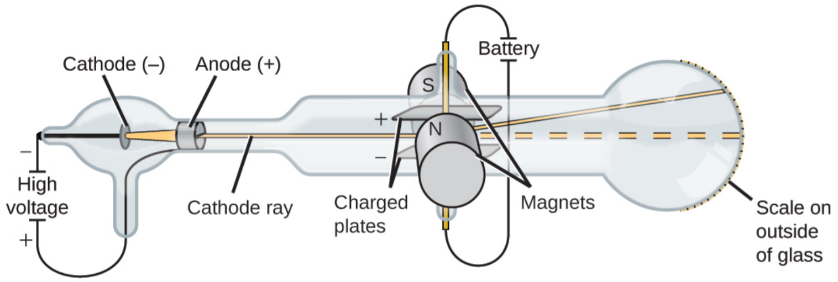
CRT – Discovery of the Electron

Slide 13
Discovery of the Electron
In 1897, J.J. Thompson used a cathode ray tube to discover electrons
Cathode ray tubes are sealed glass tubes with most of the air removed
A high voltage is applied across two electrodes causing a beam of particles to flow from the cathode (negatively charged electrode) to the anode (positively charged electrode)
The ray can be detected by painting a phosphor coating onto the far end of the tube (emits light when hit by beam)

Slide 14
Discovery of Electrons
Thompson placed charged electric plates on either side of the tube and found that the beam deflected away from the negatively charged plate
Thompson also observed the beam responded to magnets on either side of the tube

Slide 15
Discovery of the Electron
Thompson used these experiments to determine the ratio of mass to charge and found that the beam was made of negatively charged particles almost 2000 less the mass of a hydrogen atom
Thompson repeated these experiments with different metals for electrodes and got the same results

Slide 16
Summary of J.J. Thomson’s work
Cathode rays are composed of negatively charged particles
The particles must exist within atoms since the mass of each is about 1/2000 the mass of a hydrogen atom
These subatomic particles can be found within atoms of all elements
These particles were eventually named electrons
Atoms are neutral so there must be positive particles in the atom to balance the charge
Most of the mass is not within electrons

Slide 17
The plum pudding model
Thomson knew that atoms had an overall neutral charge, therefore there must also be a positive charge
Thomson proposed that atoms had negative particles floating in a soup of positive charge – he called this the “plum pudding model” of the atom

Slide 18
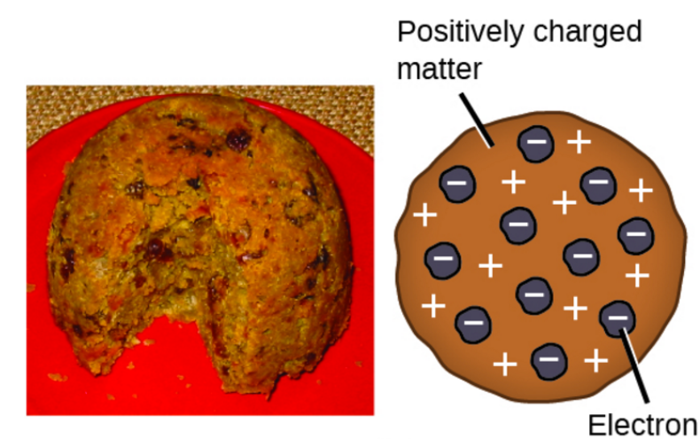
Plum Pudding

Slide 19
Rutherford’s Gold Foil Experiment
Rutherford fired a thin beam of alpha particles at a very thin sheet of pure gold
Thomson’s model shows the mass spread evenly in an atom
Rutherford predicted that most alpha particles would pass straight through the gold foil
While most particles did pass straight through the foil, a few were deflected a bit and a very small number were deflected greater than 90°

Slide 20
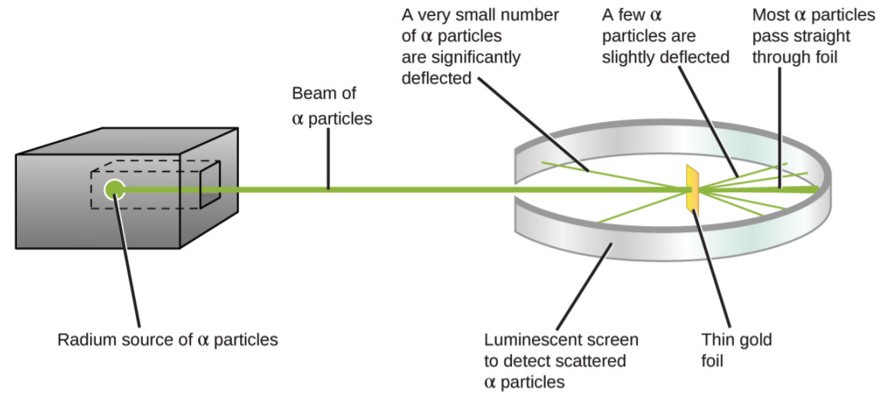
Rutherford’s Gold Foil Experiment

Slide 21
Rutherford’s Conclusions
Because most particles passed through undeflected they must have traveled through mostly empty space
Alpha particles are positively charged so deflections happened when they encountered another positive charge
Since deflections occurred only a small fraction of the time, this charge only occupied a small amount of space in the gold foil

Slide 22
Rutherford’s Nuclear Model
Rutherford drew two conclusions:
1) the volume occupied by an atom must consist of a large amount of empty space
2) The nucleus is:
Small
Dense
Positively charged

Slide 23
Distinguishing among atoms (4.3)
Explain what makes elements and isotopes different from each other
Calculate the number of neutrons in an atom
Calculate the atomic mass of an element

Slide 24
Atomic Number
Atoms are composed of identical protons, neutrons, and electrons
Elements are different from each other because they contain a different number of PROTONS
The “atomic number” of an element is the number of protons in the nucleus
In a neutral atom:
# protons in an atom = # electrons

Slide 25
Atomic Number
Atomic number (Z) of an element is the number of protons in the nucleus of each atom of that element
Element | # of protons | Atomic # (Z)
Carbon | 6 | 6
Phosphorus | 15 | 15
Gold | 79 | 79

Slide 26
Mass Number
Mass number is the number of protons and neutrons in the nucleus of an isotope:
Mass # = p⁺ + n⁰
Nuclide | p⁺ | n⁰ | e⁻ | Mass #
Oxygen - |  | 10
- | 33 | 42
- 31 | 15
18
8
8
18
Arsenic
75
33
75
Phosphorus
16
15
31

Slide 27
Nuclear Symbols
Contain the symbol of the element, the mass number and the atomic number.
Mass
number
X
Superscript →
Atomic
number
Subscript →

Slide 28
Symbols
Find each of these:
number of protons
number of neutrons
number of electrons
Atomic number
Mass Number
80
Br
35

Slide 29
Symbols
If an element has an atomic number of 34 and a mass number of 78, what is the:
number of protons
number of neutrons
number of electrons
complete symbol

Slide 30
Symbols
If an element has 91 protons and 140 neutrons what is the
Atomic number
Mass number
number of electrons
complete symbol

Slide 31
Symbols
If an element has 91 protons and 140 neutrons what is the
Atomic number
Mass number
number of electrons
complete symbol

Slide 32
Isotopes
Dalton was wrong about all elements of the same type being identical
Atoms of the same element can have different number of neutrons and thus different mass numbers
These are called isotopes

Slide 33
Naming Isotopes
We can also put the mass number after the name of the element:
carbon-12
carbon-14
uranium-235

Slide 34


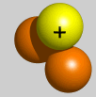
Isotopes are atoms of the same element having different masses, due to varying numbers of neutrons.
Isotope | Protons | Electrons | Neutrons | Nucleus
Hydrogen–1 (protium) | 1 | 1 | 0
Hydrogen-2 (deuterium) | 1 | 1 | 1
Hydrogen-3 (tritium) | 1 | 1 | 2

Slide 35
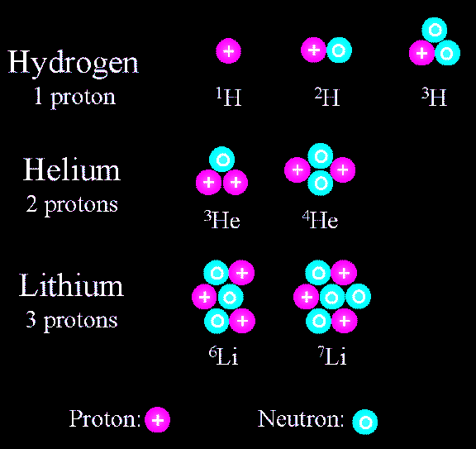
Isotopes
Elements occur in nature as mixtures of isotopes.
Isotopes are atoms of the same element that differ in the number of neutrons.

Slide 36
Atomic Mass
How heavy is an atom of oxygen?
It depends, because there are different kinds of oxygen atoms.
We are more concerned with the average atomic mass.
This is based on the abundance (percentage) of each variety of that element in nature.
We don’t use grams for this mass because the numbers would be too small.

Slide 37
Measuring Atomic Mass
Instead of grams, the unit we use is the Atomic Mass Unit (amu)
It is defined as one-twelfth the mass of a carbon-12 atom.
Carbon-12 chosen because of its isotope purity.
Each isotope has its own atomic mass, thus we determine the average from percent abundance.

Slide 38
To calculate the average:
Multiply the atomic mass of each isotope by its abundance (expressed as a decimal), then add the results.
If not told otherwise, the mass of the isotope is expressed in atomic mass units (amu)

Slide 39
Atomic Masses
Atomic mass is the average of all the naturally occurring isotopes of that element.
Isotope | Symbol | Composition of the nucleus | % in nature
Carbon-12 | ¹²C | 6 protons 6 neutrons | 98.89%
Carbon-13 | ¹³C | 6 protons 7 neutrons | 1.11%
Carbon-14 | ¹⁴C | 6 protons 8 neutrons | <0.01%
Carbon = 12.011

Slide 40
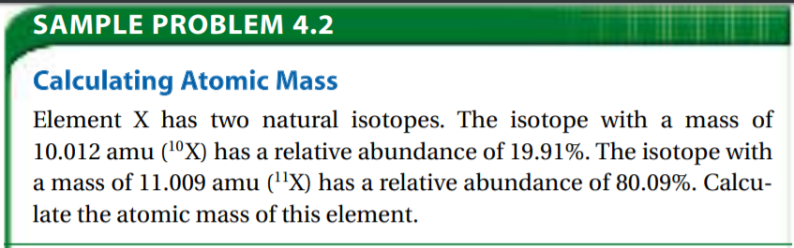
- Page 117

Slide 41
Questions for Practice
4.1 Section Assessment #1 – 7
4.2 Section Assessment #8 – 14
Practice Problems
Page 112 #17, 18
Page 113 #19, 20
Page 116 #21, 22
Page 117 #23, 24
4.3 Section Assessment #25 - 33

Slide 42
Questions for Review
Page 122 – 123 #34, 36, 38, 39, 40, 41, 42, 43, 44, 45, 46, 47, 48, 49, 50, 51, 52, 53, 54, 55, 56, 60, 61, 63, 64, 65, 69, 71, 73
Additional worksheets may also be given

